Slide 1
Basic Spring 5.0
Spring RESTFul Web Services
Notes:
Add instructor notes here.

Slide 2
Lesson Objectives
Spring MVC REST Workflow
SpringREST Introduction
Life cycle of a Request in Spring MVC Restful
Why REST Controller ?
HTTP methods in REST
HTTP Status Code
HTTP request Mapping
RESTful URLs – HTTP methods
@PathVariable, @RequestBody Annotation
ResponseEntity Object
Cross-Origin Resource Sharing (CORS)
REST Testing
Spring RestTemplate methods

Slide 3
6.1 Spring MVC REST Workflow
Client
Request
Dispatcher Servlet
Handler Mapping
Response
ResponseEntity
RestController
Spring5 MVC REST Workflow
Notes:
Spring’s annotation based MVC framework simplifies the process of creating RESTful web services. The key difference between a traditional Spring MVC controller and the RESTful web service controller is the way the HTTP response body is created. While the traditional MVC controller relies on the View technology, the RESTful web service controller simply returns the object and the object data is written directly to the HTTP response as JSON/XML
Spring MVC REST Workflow
The following steps describe a typical Spring MVC REST workflow:
The client sends a request to a web service in URI form.
The request is intercepted by the DispatcherServlet which looks for Handler Mappings and its type. • The Handler Mappings section defined in the application context file tells DispatcherServlet which strategy to use to find controllers based on the incoming request. • Spring MVC supports three different types of mapping request URIs to controllers: annotation, name conventions and explicit mappings.
Requests are processed by the Controller and the response is returned to the DispatcherServlet which then dispatches to the view.

Slide 4
6.2 Spring REST Introduction
@RestController = @Controller + @ResponseBody
RestController class should be annotated as @RestController
Returns JSON,XML,html,text,etc., from controller
By default it returns JSON
@RestController
public class CountryController {
@RequestMapping(value = "/countries", method = RequestMethod.GET,headers="Accept=application/json")
public List getCountries()
{
List listOfCountries = new ArrayList();
listOfCountries=createCountryList();
return listOfCountries;
}
Notes:
Spring has a list of HttpMessageConverters registered in the background. The responsibility of the HTTPMessageConverter is to convert the request body to a specific class and back to the response body again, depending on a predefined mime type. Every time an issued request hits @ResponseBody, Spring loops through all registered HTTPMessageConverters seeking the first that fits the given mime type and class, and then uses it for the actual conversion.

Slide 5
6.3 Life cycle of a Request in Spring MVC Restful
HandlerMapping
(@RequestMapping)
DispatcherServlet
RestController
HttpRequest
HttpResponse
Client
Notes:
REST(Representational State Transfer) is an architectural style with which Web Services can be designed that serves resources based on the request from client. A Web Service is a unit of managed code, that can be invoked using HTTP requests. You develop the core functionality of your application, deploy it in a server and expose to the network. Once it is exposed, it can be accessed using URI's through HTTP requests from a variety of client applications. Instead of repeating the same functionality in multiple client (web, desktop and mobile) applications, you write it once and access it in all the applications.
In the above diagram, from the time that a request is received by Spring until the time that a response is returned to the client, many pieces of Spring Restful webservices are involved.
The process starts when a client (typically a web browser) sends a request. It is first received by a DispatcherServlet. Like most Java-based MVC frameworks, Spring MVC uses a front-controller servlet (here DispatcherServlet) to intercept requests. This in turn delegates responsibility for a request to other components of an application for actual processing.
The Spring MVC uses a Controller component for handling the request. But a typical application may have several controllers. To determine which controller should handle the request, DispatcherServlet starts by querying one or more HandlerMappings. A HandlerMapping typically maps URL patterns to RestControllers.
Once the DispatcherServlet has a appropriate RestController selected, it dispatches the request to that Controller which performs the business logic (a well-designed RestController object delegates responsibility of business logic to one or more service objects). Upon completion of business logic, HTTPResponse is generated and sent back to the client.
Slide demonstrates Life cycle of Spring RESTful services.
Along with that also explains why Rest controllers were introduced.

Slide 6
6.4 Why REST Controller ?
Server should deal with only data.
Popular front-end frameworks like Angular, EmberJs, ReactJs etc.,
Expose the data as JSON/XML/HTML/plain text.
Server can process business logic quickly
Server no need to produce presentation tier.
Elimination of JSP from current Architecture.
Leads API-led connectivity Architecture
Encourage microservices kind of application in enterprise architecture.

Slide 7
6.5 HTTP methods in REST
HTTP Method | Operation | Comment
GET | Read Operation only | Uses only for the read operation.GET should be idempotent
POST | Create new resource | Should only be used to create a new resource
PUT | Update / Replace Resource | Update an existing resource.Think of PUT method as putting a resource
DELETE | Delete Resource | To remove a given resource.DELETE operation is idempotent
PATCH | Partial Update / Modify | Partial update to a resource should happen through PATCH

Slide 8
6.6 HTTP Status Code
Status Code Category | Description | Example
1XX – Informational | Informational indicates a provisional response | 100 (Continue ) , 101
2XX – Successful | This class of status code indicates that the client’s request was successfully received, understood, and accepted. | 200 (OK), 201(Created), 202 (Accepted)
3XX – Redirection | This class of status code indicates that further action required by the user agent to fulfill the request | 301 (Moved Permanently), 302, 304
4XX – Client Error | The 4xx class of status code is intended for cases where the client seems to have erred | 400 ( Bad Request), 401, 403, 404, 405
5XX – Server Error | Response status codes beginning with the digit “5” tell cases where the server is aware that it has erred or is incapable of performing the request | 500 (Internal Server Error), 502, 503, 505

Slide 9
6.6 HTTP Status Code
200 - OK
201 - Created
202 - Accepted
304 - Not Modified
400 - Bad Request
401 - Unauthorized
403 - Forbidden
404 - Not Found

Slide 10
6.7 HTTP request mapping
@RequestMapping
@GetMapping
@PostMapping
@PutMapping
@DeleteMapping
@PatchMapping

Slide 11
6.8 RESTful URLs – HTTP methods
Client
http://localhost:9090/SpringRESTWebServices/rest/countries
Fetching all country details – HTTP Get
Client
http://localhost:9090/SpringRESTWebServices/rest/countries/new
Creating a new country – HTTP Post
Client
http://localhost:9090/SpringRESTWebServices/rest/countries/newDel
Deleting an existing country – HTTP Delete
Notes:
The slide demonstrates different RESTful URLs with respect to different HTTP methods.
Demo: SpringRESTWebServices can be used as a reference.
Note: At times if the HTTP Get is used over a couple of RestController methods it has to be combined with URL patterns to create unique identifications.
In the above slide first URL pattern demonstrates : HTTP Get method to fetch all country details.
Similarly if details for a particular country need to be fetched then the country id can be appended in URL and extracted via the @PathVariable
http://localhost:9090/SpringRESTWebServices/rest/countries/3 -> With this URL country details are fetched for country Id = 3
2. The second URL pattern demonstrates : HTTP Post method to create a new country
3. The third URL pattern demonstrates : HTTP Delete method to delete an existing country
Note: As HTML supports only Get and Post methods for the method attribute in the form tag; we also need to map the HTTP PUT(update) and HTTP DELETE (delete) methods to update and delete the resources respectively.
For this Spring provides us with a Filter-mapping which is to be given in web.xml file:
<filter>
<filter-name>httpMethodFilter</filter-name>
<filter-class>org.springframework.web.filter.HiddenHttpMethodFilter</filter-class>
</filter>
<filter-mapping>
<filter-name>httpMethodFilter</filter-name>
<servlet-name>dispatcher</servlet-name>
</filter-mapping>
By using this Spring in-built filter the different methods of HTTP specification will be mapped to their actual HTTP implementations.
Here the filter will be intercepted for all the requests coming to DispatcherServlet.
Also in the JSP pages for updating and deleting a country need to pass a HTML hidden parameter : For example
<input type="hidden" name="_method" value="delete"/> to pass the “real” HTTP method to Spring Rest Controller.
Trainer can explain concept of URL mapping to different HTTP methods and notes page by referring the demo code shared : SpringRESTWebServices

Slide 12
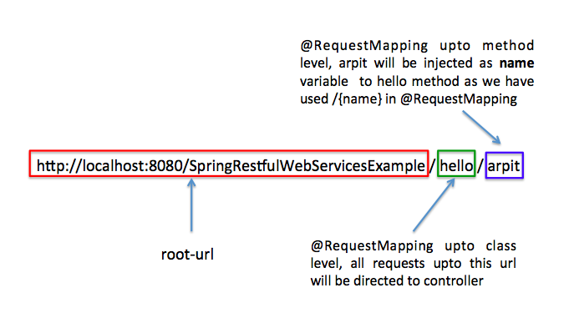
6.9 @PathVariable Annotation
Used to inject values from the URL into a method parameter. This way you inject name in hello method .
@RestController
@RequestMapping("/hello")
public class SpringRestController {
@RequestMapping(value = "/{name}",
method = RequestMethod.GET)
public String hello(@PathVariable String name) {
String result="Hello "+name;
return result;
}
}

Slide 13
6.9 ResponseEntity Object
ResponseEntity is a generic type
Used to Manipulate the HTTP Response
Represents the whole HTTP response: status code, headers, and body
provides two nested builder interfaces: HeadersBuilder and its subinterface, BodyBuilder
Alternate for ResponeEntity - @ResponseBody, @ResponseStatus and HttpServletResponse
@GetMapping("/hello")
ResponseEntity<String> hello() {
return new ResponseEntity<>("Hello World!", HttpStatus.OK);
}

Slide 14
6.9 @RequestBody annotation
If a method parameter is annotated with @RequestBody, Spring will bind the incoming HTTP request body(for the URL mentioned in @RequestMapping for that method) to that parameter.
While doing that, Spring will use HTTP Message converters to convert the HTTP request body into domain object [deserialize request body to domain object], based on Accept header present in request.
@RestController
public class EmployeeController {
@Autowired
IEmployeeService empservice;
@RequestMapping(value ="/employee/create/", consumes = MediaType.APPLICATION_JSON_VALUE, headers="Accept=application/json",method = RequestMethod.POST)
public List<Employee> createEmployee(@RequestBody Employee emp) {
empservive.addEmployee(emp);
return empservice.getAllEmployee();
} }

Slide 15
6.10 Cross-Origin Resource Sharing (CORS)
CORS (Cross-origin resource sharing) allows a webpage to request additional resources into browser from other domains e.g. fonts, CSS or static images from CDNs.
Helps in serving web content from multiple domains into browsers who usually have the same-origin security policy.
Spring CORS support in Spring MVC application at method level and global level.
@CrossOrigin allows all origins, all headers, the HTTP methods specified in the @RequestMapping annotation and a maxAge of 30 minutes.
Notes:
Reference : https://developer.mozilla.org/en-US/docs/Web/HTTP/CORS

Slide 16
6.10 @CrossOrigin Annotation Attributes
Origins - List of allowed origins. It’s value is placed in the Access-Control-Allow-Origin header of both the pre-flight response and the actual response.
– * – means that all origins are allowed.
– If undefined, all origins are allowed.
allowedHeaders - List of request headers that can be used during the actual request. Value is used in preflight’s response header Access-Control-Allow-Headers.
– * – means that all headers requested by the client are allowed.
– If undefined, all requested headers are allowed.
methods - List of supported HTTP request methods. If undefined, methods defined by RequestMapping annotation are used.
exposedHeaders - List of response headers that the browser will allow the client to access. Value is set in actual response header Access-Control-Expose-Headers.
– If undefined, an empty exposed header list is used.
Notes:
Reference : https://developer.mozilla.org/en-US/docs/Web/HTTP/CORS

Slide 17
6.10 @CrossOrigin Annotation Attributes
allowCredentials - It determine whether browser should include any cookies associated with the request.
– false – cookies should not included.
– "" (empty string) – means undefined.
– true – pre-flight response will include the header Access-Control-Allow-Credentials with value set to true.
– If undefined, credentials are allowed.
maxAge - maximum age (in seconds) of the cache duration for pre-flight responses. Value is set in header Access-Control-Max-Age.
– If undefined, max age is set to 1800 seconds (30 minutes).
Notes:
Reference : https://developer.mozilla.org/en-US/docs/Web/HTTP/CORS

Slide 18
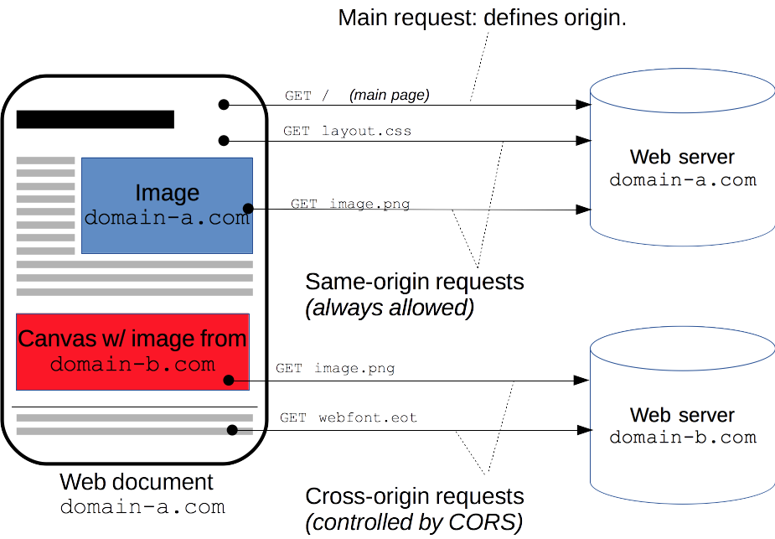
Cross-Origin Resource Sharing (CORS)
Notes:
Reference : https://developer.mozilla.org/en-US/docs/Web/HTTP/CORS
The CORS mechanism supports secure cross-domain requests and data transfers between browsers and web servers. Modern browsers use CORS in an API container such as XMLHttpRequest or Fetch to help mitigate the risks of cross-origin HTTP requests.

Slide 19
Cross-Origin Resource Sharing (CORS)
@CrossOrigin(origins = "http://localhost:4200")
@RestController
public class CountryController {
@Autowired
private ICountryService service;
//@CrossOrigin(origins = "http://localhost:4200")
@RequestMapping(value = "/countries/search/{id}",method = RequestMethod.GET,headers="Accept=application/json")
public Country getCounty(@PathVariable int id) {
return service.searchCountry(id);
}
}

Slide 20
6.11 REST Testing
Spring RestTemplate
Spring RestTemplate class is part of spring-web, introduced in Spring 3.
We can use RestTemplate to test HTTP based restful web services, it doesn’t support HTTPS protocol.
RestTemplate class provides overloaded methods for different HTTP methods, such as GET, POST, PUT, DELETE etc.
URI | HTTP METHOD | DESCRIPTION
/springData/person | GET | Get all persons from database
/springData/person/{id} | GET | Get person by id
/springData/person | POST | Add person to database
/springData/person | PUT | Update person
/springData/person/{id} | DELETE | Delete person by id

Slide 21
6.12 Spring RestTemplate Methods
Get:
getForObject, getForEntity
Post:
postForObject(String url, Object request, Class responseType, String…​ uriVariables) postForLocation(String url, Object request, String…​ urlVariables),
Put:
put(String url, Object request, String…​urlVariables)
Delete:
delete()
Head:
headForHeaders(String url, String…​ urlVariables)
Options:
optionsForAllow(String url, String…​ urlVariables)

Slide 22
Demo: SpringRESTDemos
SpringRESTDemo
Notes:
These demos can be executed for better understanding

Slide 23
Summery
Spring MVC REST Workflow
SpringREST Introduction
Life cycle of a Request in Spring MVC Restful
Why REST Controller ?
HTTP methods in REST
HTTP Status Code
HTTP request Mapping
RESTful URLs – HTTP methods
@PathVariable, @RequestBody Annotation
ResponseEntity Object
Cross-Origin Resource Sharing (CORS)
REST Testing
Spring RestTemplate methods
Notes:
References:
https://www.genuitec.com/spring-frameworkrestcontroller-vs-controller/

Slide 24
Spring ReSTful Lab
Lab 2
Notes:
Add the notes here.
Corresponding lab assignment

Slide 25
Review Question
Question 1: How to access URI parameters in Spring REST?
@RequestParam
@QueryParam
@PathVariable
@ResponseParam
Question 2: ___________ is used to test RESTful API in Spring framework?
RestTemplate
RestAPITemplate
Junit
JQuery
Notes:
Add the notes here.
Question 1: Option 1, Option 2
Question 2: True

Slide 26
Review Question
Question 3: ___________ specifies a media type a resource can generate.
@PUT
@POST
@Produces
@Consumes
Notes:
Add the notes here.
Question 3: @Produces

